Slide 1
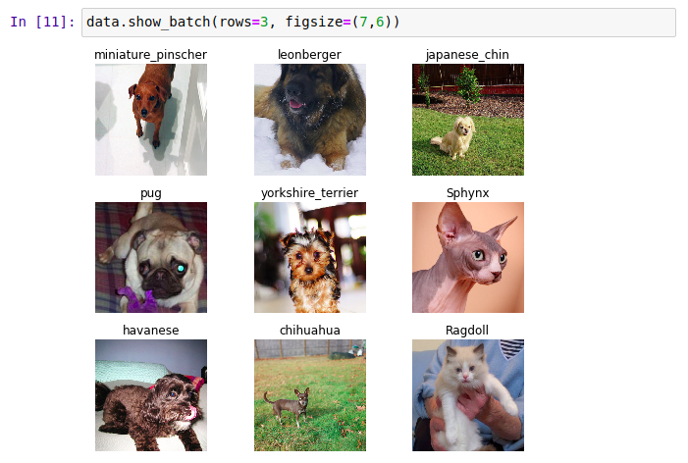
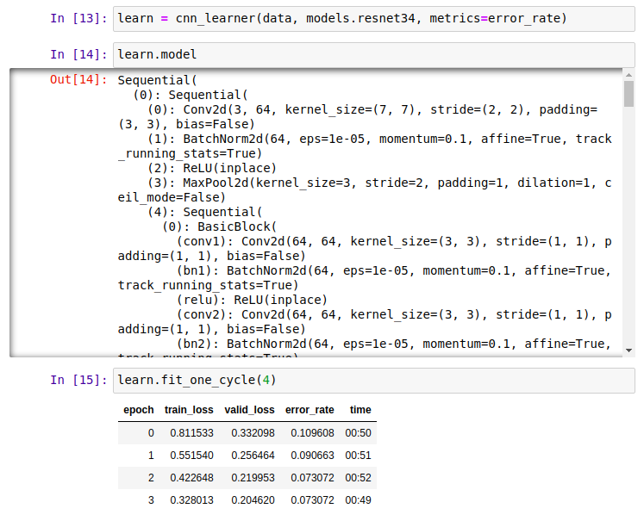
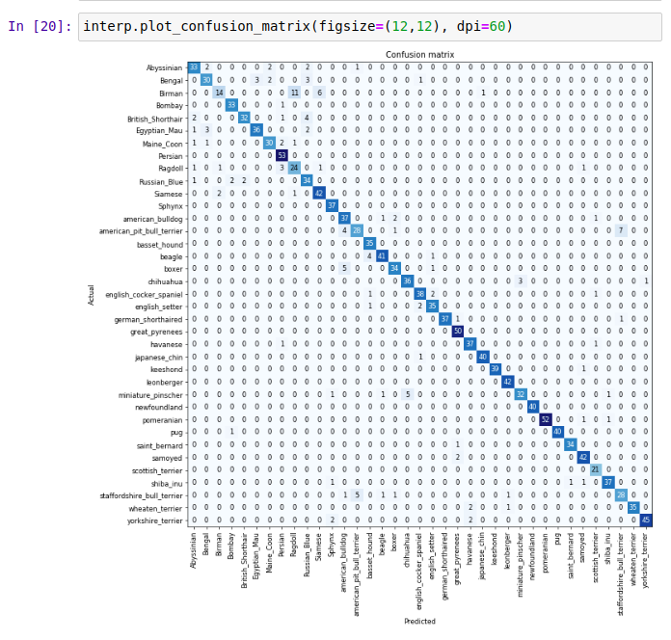

fast.ai
Making neural nets
uncool again
Josiah Laivins
February 23, 2020
(1)
Notes:
hi everyone, my name is josiah laivins. I am a graduate student here studying artificial intelligence and robotics. I currently work full time at Mariner doing deep learning model development, tooling, and deployment for manufacturing.
So this work shop is on fastai. I was first introduced to it while doing a hackathon where I needed a fast way to download the data provided by the hackathon, and test many different deep learning models on it in a short amount of time. I found fastai to be extremely easy and useful for this. In parallel, my boss started experimenting with it before I starting working for him. fastai is being developed out of the university of sanfrancisco and is lead by this guy named jeremy howard, definiately check him out.

Slide 2
Black Box
Interpretable ML
Visualize Gradients and activations
Needs too much data
Transfer learning
Share pre-trained nets
Needs ML PhD
No longer true
Fastai & keras libs MOOCs, etc
Only for vision
No longer true
SoTA for speech, structured data, time series...
Needs lots of GPUS
Was never true
… except for some research projects
"Not really AI"
Who cares
Do you really want to build a brain
Description from: https://course.fast.ai/videos/?lesson=1
(2)
Notes:
Ok so what are some problems or misoncceptions about deep learning? Deep learning is a black box. When first learning about machine learning and deep learning this is a common issue that everyone from beginners to professionals run into. Since deep learning models are large collections of inconnectred neurons, you can do classical debugging like you would if you programmed a computer vision algorithm from scratch. However based on personal experience, most of the problems you will run into can actually be explainable. Some examples are issues in the dataset you're using, over fitting, and adjusting learning rates.
Needs too much data: Today you don't need an enourmous amount of data because many larger compoanies like microsoft and google have done the heavy work for you. fastai makes this easy to download the existing model weights, and so you only need to train part of it.
Needs ML PhD: You definately don't need a PhD for deep learning now. Most of the state of the art models are easily accessible, and all you need to do is the data collection and tweaking.
Only for vision: In this workshop we'll be doing mainly vision, partially because I'm most familier with it and at my work we primarily use vision, but also because vision is the most mature part of fastai. However other parts such as for tabular data like spreadsheets are very easy to setup and get good results from, and other parts for natural language processing.
Needs lots of GPUs: So I personally don't want this to be true, and at the moment this is true in some areas, students here in natural language processing can correct me if im work, but training in those areas are still slow. I have definiately found that we will would want multiple GPUs for reinforcement learning. With this said, jeremy howard stated that most of the big leaps in deep learning are not due to more processing power, but advances in better models.
Finally, I will point out that neural nets in computer terms still don't learn or act like biological neurons and are less efficient, but that should not stop you doing research in deep learning or applying what we'll today to solve real world problems.

Slide 3
Making Deep Learning Accessible
Software
To make these available to use quickly, reliably, and with minimal code
Community
So that we can all help each other
Research
Ways to make state of the art deep learning techniques more accessible
Education
So that as many people as possible use these
Description from: https://course.fast.ai/videos/?lesson=1
(3)
Notes:
This is kind of the manefest that fastai tries to trive for.
Software should be available, reliable, and require minimal code. This may seem obvious, but if you try out computer vision models from companies like microsoft, you will quickly realize that this opinion is obsolutely not shared by everyone.
Community: fastai has a cool forum that they seem to have built from scratch that you interact with. They also use github so any technical issues you can send there.
Research: fastai does publish papers. One of the most frusterating things in deep learning is if you make your own model or methodology, how do you compare it will someone elses? Everywhere else this extremely time intensive.

Slide 4




What is fastai?
Popular ML library
One of the most popular programming languages
Different from classical programming. "friendlier".
[1] https://pytorch.org/
[2] https://python.org/
[3] https://jupyter.org/
(4)
Notes:
Ok so what is fastai? This is a library that is built on time of pytorch which is a deep learning library/framework developed by facebook. It is extremely popular, and companies like fastai have recently been moving their frameworks to natively support it. Just for comparison, there is another framework called tensorflow developed by google that does the same thing, except way more complicated. They have make their library easier to use though.
Python is my favorate langauge. It lets you do a lot with very little code and has a massive community developing libraries for it. I could right now train a deep learning model, load that model on a database in the cloud, run a robot from that database, and watch the robot in realtime from a website all using python.
Jupyter notebooks is a environment that people, mostly data scientists use from programming and documenting code at the same time. This make it easier for you to prototype something and allow other people, even non-programmers to read it and understand generally what you're trying to do.
All of these are grouped together into a frame we call fastai.

Slide 5
Who is fastai for?
Newbie's
Tied to a course for anybody to learn from
No math required to get into ML
Jupyter notebooks are far friendlier than most IDEs
Experienced Data Scientists
Existing API code for pipelining
Easy comparison between other models
Attached course goes into detailed topics
Established codebase to build on top of
Description from: https://course.fast.ai/videos/?lesson=1
(5)
Notes:
So who is this for?
If youre are new to deep learning this is a great start. Most of your techinical issues will be likely related to the dataset your using as opposed to how you created your model. It the MOOC is a great resource also. You will notice that each course is about 2 hours, but the actual code is really short. This is because alot of time is spend talking about the idea because a peice of code, why you want to use it, when you want to use it.
If your experienced at data science, then this is still important for you. I know personally I created 3 mini-frameworks all coded to pipeline whatever data I am trying to work with. And everytime they were different, I had technical issues just related to the loop, data loading, and image manipulation. So fastai will take care of that for you so if you switch projects, you dont need to start from scratch. The MOOC also goes into a lot of detail especially in part 2 of the course.

Slide 6
DataBunch
Images, text, audio
Data transformation
Data analysis
Model
Neural net being trained
Atomic and portable
DataBunch
Learner
Model
Interpretation
Learner
Contains everything
Says how and when things should happen
Interpretation
Post training quick analysis of model performance, troubleshooting
(6)
Notes:
Ok so fastai tackle the entire pipeline of training a model.
A DataBunch is part of their data_block code. This is how you load images, text, or tabular data for a model to use.
The Learner is the big object that glues everything together.
Model is the neural net you are trying to train. This is the smallest, and most portable part of the pipeline.
Interpretation objects are the reason I like fastai so much. This is how you figure out what is wrong with it, is it because something is bad in the data? are there labels that are doing worse than others?
So why is this better than whatever if offered by pytorch? You would be seprised that the Databunch data loading can actually require more code than the actual model. You need to load images, resize them, maybe do transoformations on them, lump them into groups or batches. If you change your dataset, you might have to throw this all out and re-code from scratch.
Learner handles the actual training of your model. Once again, training a model involves looping through your data, recording results such as you accuracy, loss. You want to record your validation performance, basically how will you model is doing on data that it has never seen before? And what happens if you want to train someone else's model to see how they compare? You might need to re-code your training code to handle their model.
Interpretation: If you start deep learning from scratch you will want to produce graphs and figures. Before fastai, I definiately would spend an enourmouse amount of time on this. Graph code can be seprisingly complex.
So fastai has these components here already made, and did a good job making everything be mauable enough to change datasets, training methods, and models. Obviously, if you need to modify one of these to work of a unique problem your trying to solve, they have a massive amout of documentation on how to do this. I personally made a reinforcement learning pipeline subclassing these and it all works pretty well. However for most of you I don't expect you will need to do this. At my job we have definiately not had to do this.

Slide 7
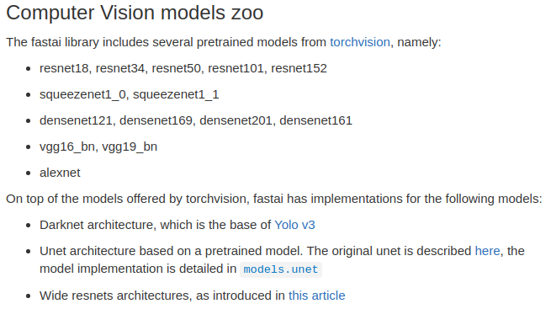
fastai
vision models
[1] https://docs.fast.ai/vision.models.html
(7)
Notes:
Here is a list of computer vision models. Some of these have nothing to do with fastai, such as the resnet models. Those are actually part of pytorch.

Slide 8
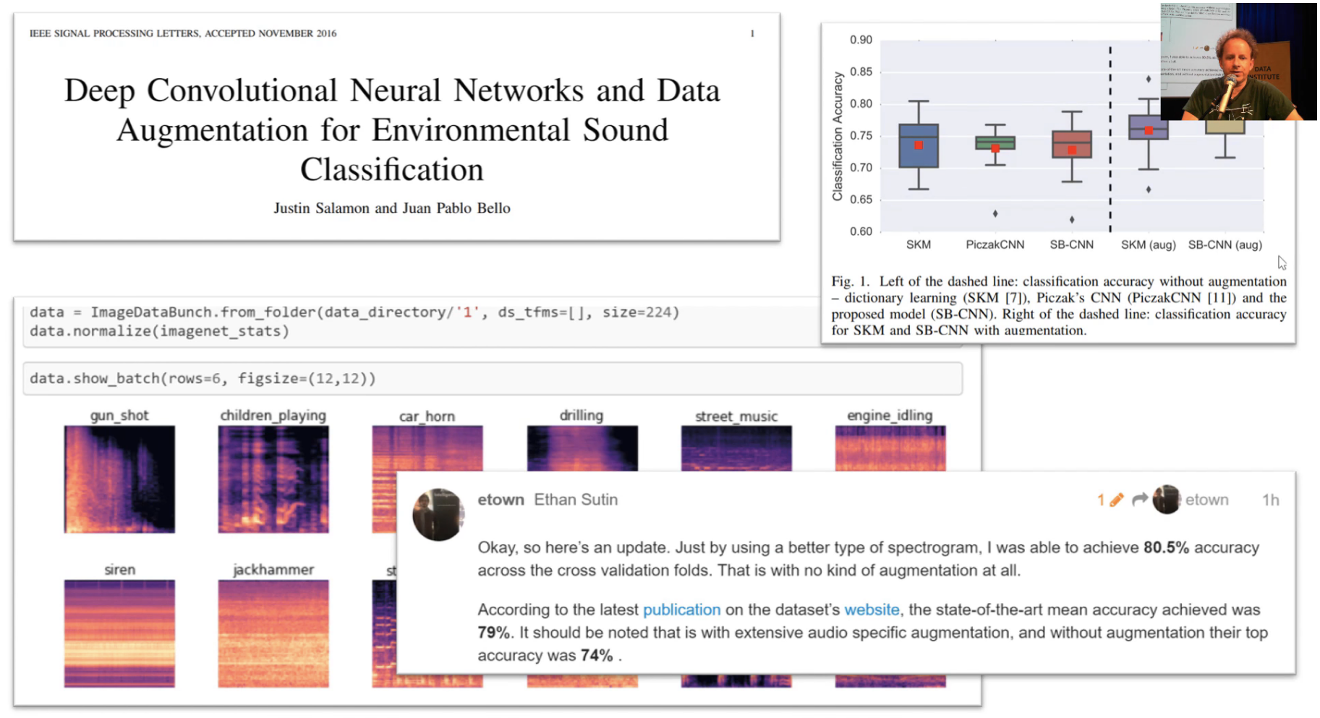
[1]: https://github.com/hiromis/notes/blob/master/Lesson2.md
[2]: https://forums.fast.ai/t/share-your-work-here/27676/215
(8)
Notes:
And im going to just go through some projects people already worked on on using fastai, for example this guy trained a model on images of audio sound waves for classification and was able to beat this dataset's highest accaracy at that time.

Slide 9
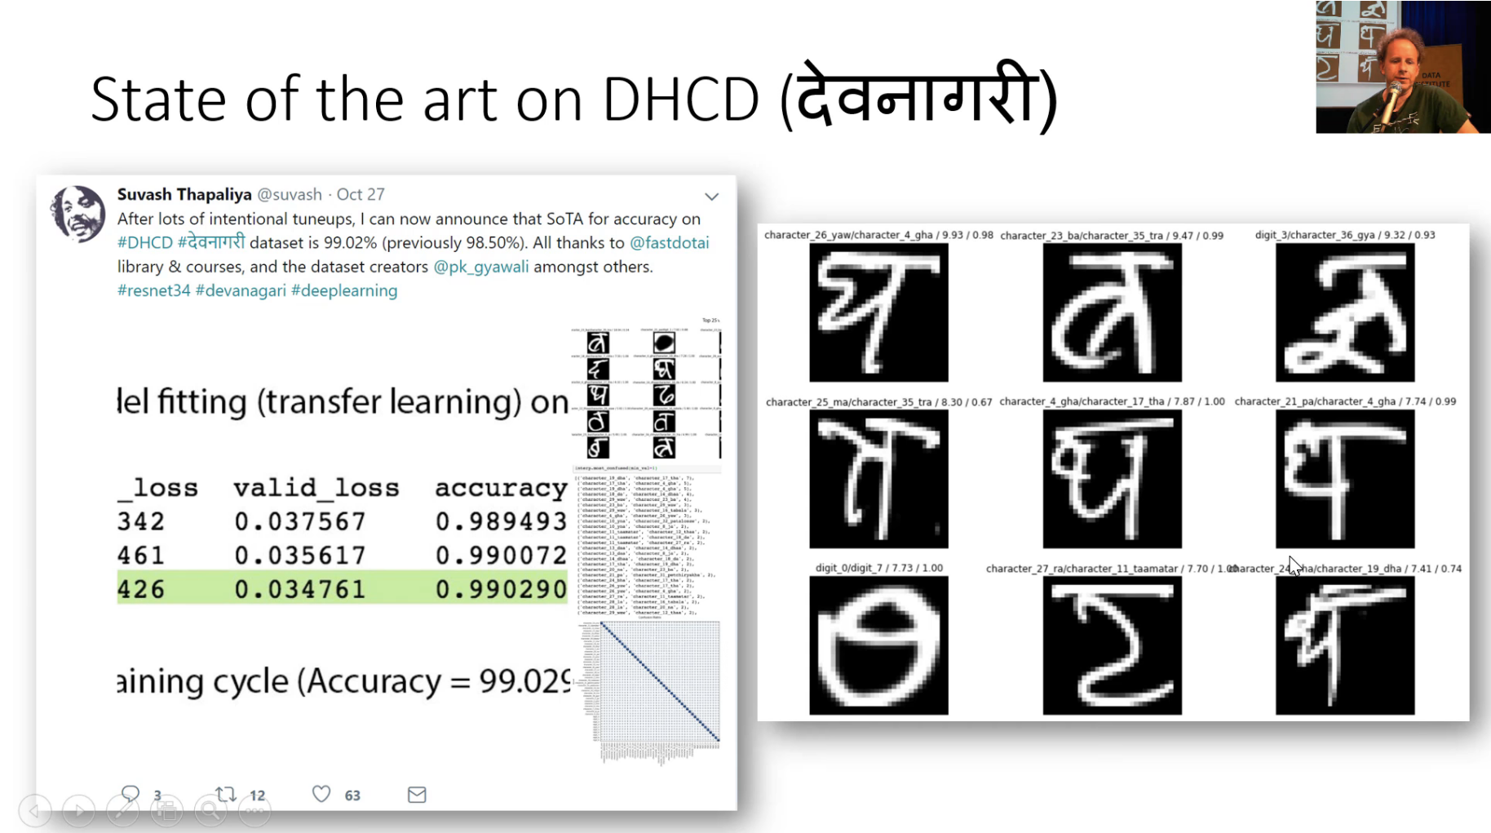
[1]: https://github.com/hiromis/notes/blob/master/Lesson2.md
[2]: https://forums.fast.ai/t/share-your-work-here/27676/38
(9)
Notes:
This person was able to beat state of the art accuracy on the DHCP dataset (Devnagari Handritten Character Dataset). You could say this is a harder version of the MNIST dataset. The DCHP dataset has 46 different characters while the MNIST dataset has only 10.

Slide 10
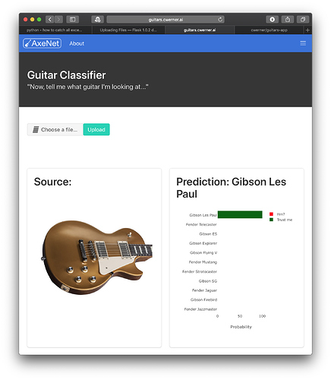
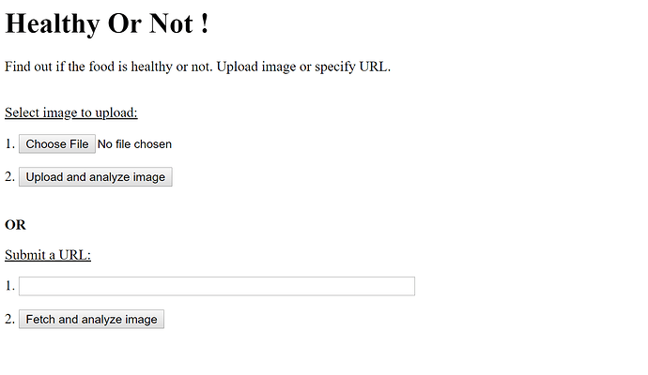
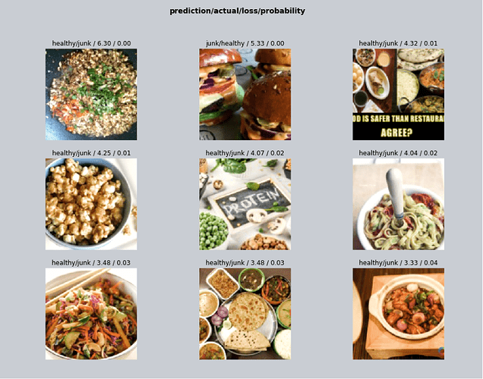
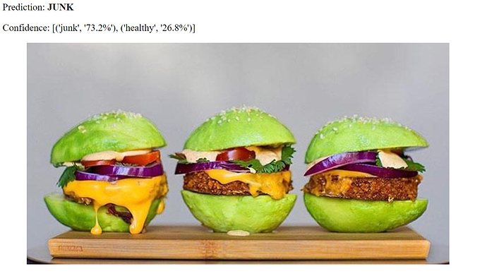
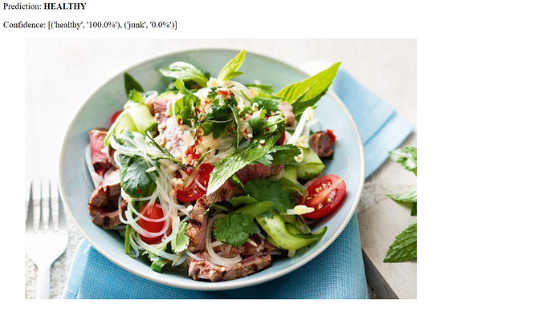
Guitar Classifier
Junk or Health Food Classifier
[1]: https://github.com/hiromis/notes/blob/master/Lesson3.md
[2]: https://forums.fast.ai/t/share-your-work-here/27676/399
[2]: https://forums.fast.ai/t/share-your-work-here/27676/340
(10)
Notes:
Someone made a website for classifying guitars, while someone else trained a classifier to identify healthy food vs junk food.

Slide 11
fast.ai not just classification
(11)
Notes:
So here someone made a movie sentiment classifier for movie reviews using the fastai API. On right, a lawyer watched the fastai MOOC and decided to make a legal document classifier.

Slide 12
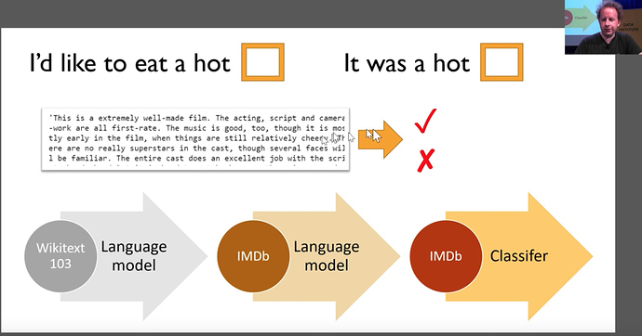
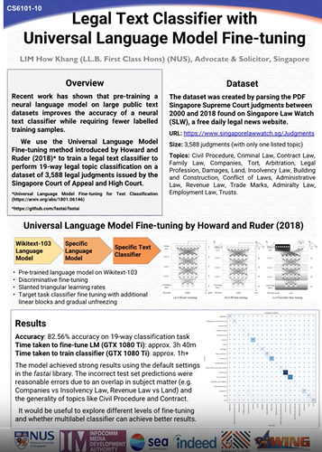
NLP
Movie Review Sentiment Classification
Legal Document Classification
[1]: https://forums.fast.ai/t/deep-learning-lesson-4-notes/30983
(11)
Notes:
So here someone made a movie sentiment classifier for movie reviews using the fastai API. On right, a lawyer watched the fastai MOOC and decided to make a legal document classifier.

Slide 13
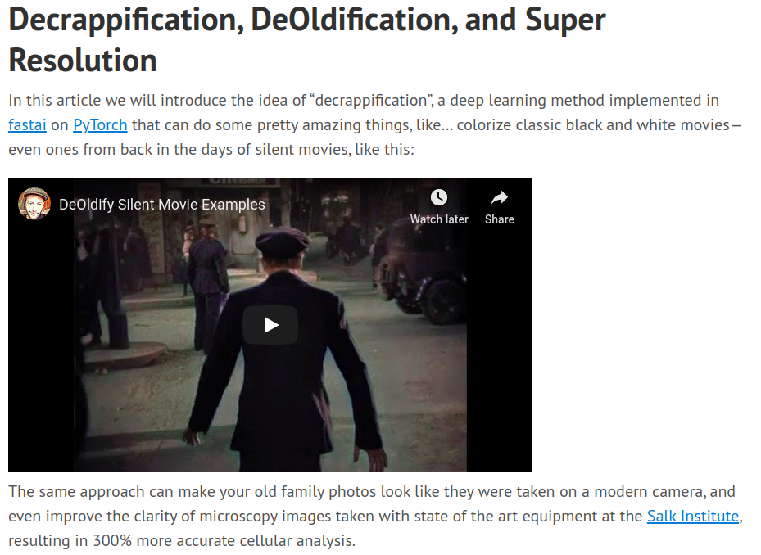
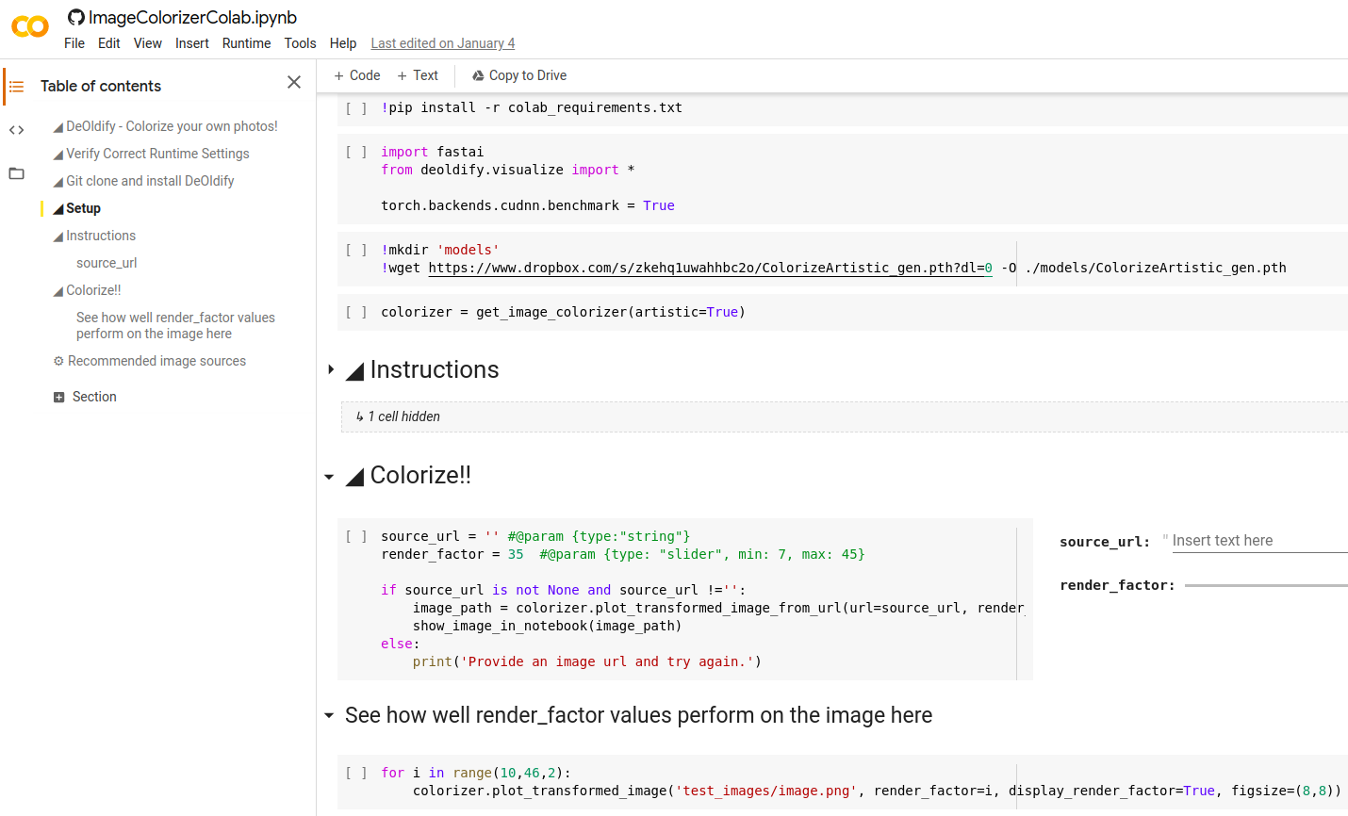
GANs
DeOldify
Colorizer
[1]: https://www.fast.ai/2019/05/03/decrappify/
[2]: https://colab.research.google.com/github/jantic/DeOldify/blob/master/ImageColorizerColab.ipynb#scrollTo=LHfUPH42O_iK
(1
2)
Notes:
GANs are really cool. Theyre 2 neural nets that fight each other which I like. I like to think that they are an early window into computers being able to have something we would have imagination. Fastai build a DeOldify Decrappy GAN, so basically when you train this GAN and it can clean up old movies, and increase resolution. There is also a project called a colorizer that will add color to black and white movies.

Slide 14
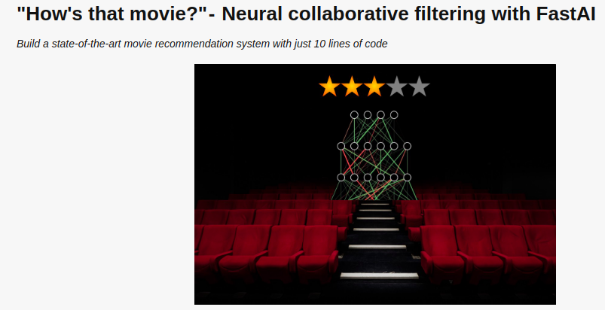
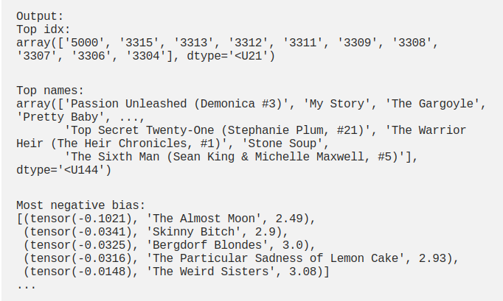
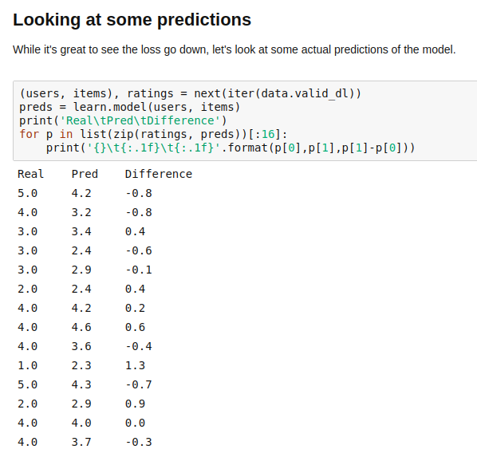
Collaborative Filtering
Movie Recommendation System
Book Recommendation System
[1]: https://course.fast.ai/videos/?lesson=4
[2]: https://towardsdatascience.com/collaborative-filtering-with-fastai-3dbdd4ef4f00
[3]: https://jovian.ml/aakashns/5bc23520933b4cc187cfe18e5dd7e2ed
(14)
Notes:
Collaberative filtering is really cool. So this would be an example of using tabular data to train a model to predict something some as predicting customer interest, or in this case what a customer would rate a movie before they watch it, or recommend books.

Slide 15
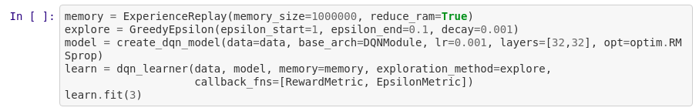
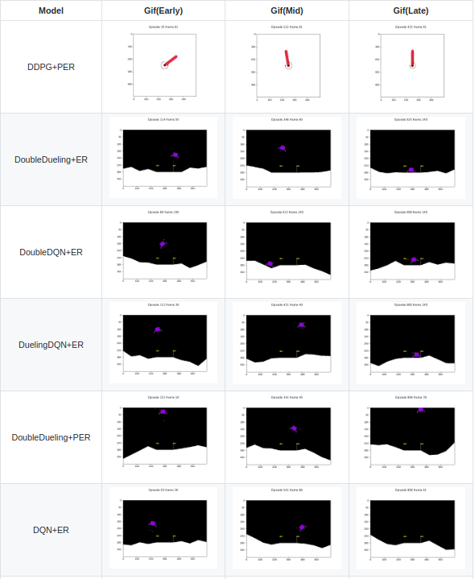
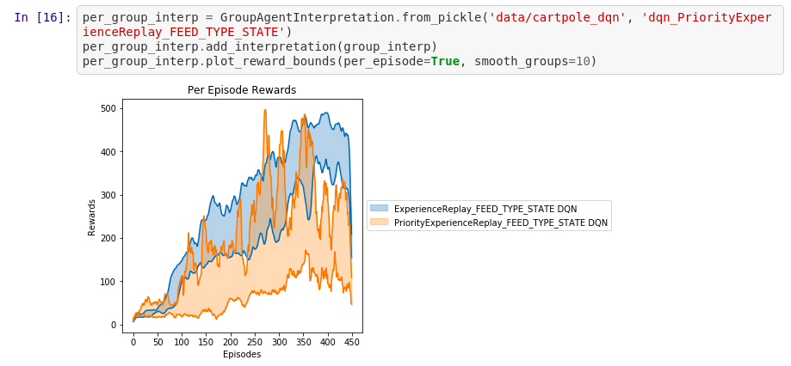
Reinforcement Learning (experimental)
[1]: https://github.com/josiahls/fast-reinforcement-learning
(15)
Notes:
Reinforcement learning. Ok so this is not connected to the fastai org in any way. I have posted in their forums. I hated training RL models, and not knowing why they were not working. Also switching environments to train in has for me in the past been really annoying. It says it has 1.0 an d dont be fooled, this just means that the library is "usuable". I am still thinking that version 3 or 4 can be considered production grade.

Slide 16
Now to coding
(16)
Notes:
Ok lets get to making a simple model.
So as first impression, how many people have used jupyter notebooks? Doesn’t look like real programming does it? We have both actual text with code in the same file. If you go the github, you will see that it even renders. These notebooks are awesome of testing new things, and documenting what you did as you go.
Note this is a heavily modified version of the fastai lesson 1 notebook, and I recommend that you do the lesson 1 course because Jeremy Howard does a better job at explaining this than me.
Don’t worry about these 3 lines of code. They are important if you are changing the original files, this notebook need to update itself.
So the first thing we need to do is import the fastai code. Fastai has different code for different deep learning problems. They have also spreadsheet code and natural language learning code.
This line is the batch size. This can determine how well your model learns, however depending on you computer, you will likely need to make the size small anough to be used by your computer.
Fastai has a lot of useful functions, untar_data makes it easy to download and unpack large datasets. You can see all the dataset you can download here (the URLs link). You can also try a custom dataset url and see if that works. If neither of those work for you, you might need to download it manually, then set the path variable to the location to your data.
MNIST is a large dataset of hand written numbers 0 to 9. It is exetremely popular for is pretty to test new models on before mvoing to more complex datasets.
This is the ImageDataBunch. It is as it says, a bunch of images. It is in charge of importing, transforming, resizing, and analyzing the data. They also have TabularDataBunch for spread sheet, csv data, TextLMDataBunch for language models, TextClasDataBunch for text classification.
So in order to import this data, we pass the path to the data, and the size of the expected image. If you make the size smaller, then it will automatically resize the images.
Next, lets look at the data we have imported. Show_batch makes this super easy. We are working with 2 classes 3s and 7s and the goal is for our model to use the pixels to learn the difference between the 2.
Simple Module
ok so this is probably the simplest neural net you can make. It has 2 layers of neurons, and uses ReLU activations. If you haven't done any deep learning before, I don't want you to worry to much about this. Even at my work we use premade models that are provided by fastai. However if you want to learn how to make neural nets from scratch using pytorch, this is a good starting point. The input is the literal number of pixels in the image, the hidden layer size is a completely arbitrary number I chose, and the output is the number of classes from the dataset.
And you can see that I just need to add it into the learner like every other fastai model. Once again, if your new to this, then I wouldnt worry too much about this.
Next is the fit function. So in deep learning it is really common to train on a number of "epochs". Which usually means that per epoch, the model looks at all the images, and tries to modify it self to do better at correctly classifying them. Here, we are allowing the model 5 chances to look at the data and try to improve its performance.
After training, we can look at the loss which is the value saying how wrong the model is. Our goal is for the model to generally go down.
(what is error rate)
We can also plot our metrics like the error rate, and accuracy.
finally, we have trained our model, but now want to know why some images it gets wrong.

Slide 17
fast.ai has a MOOC!
(17)
Notes:
fastai has a MOOC as I said before

Slide 18
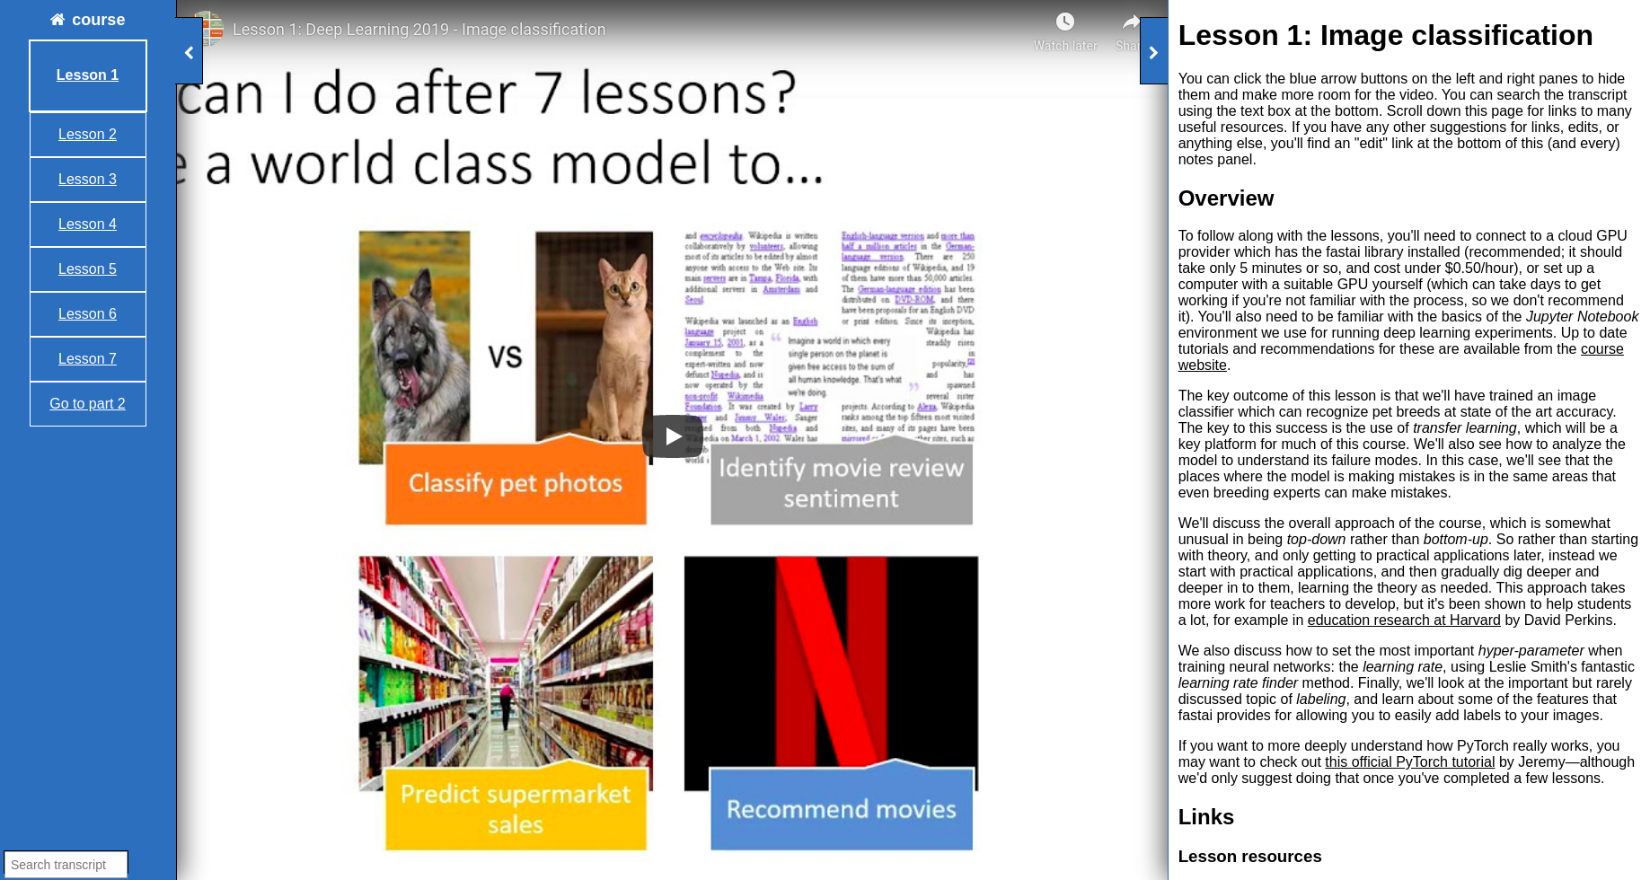
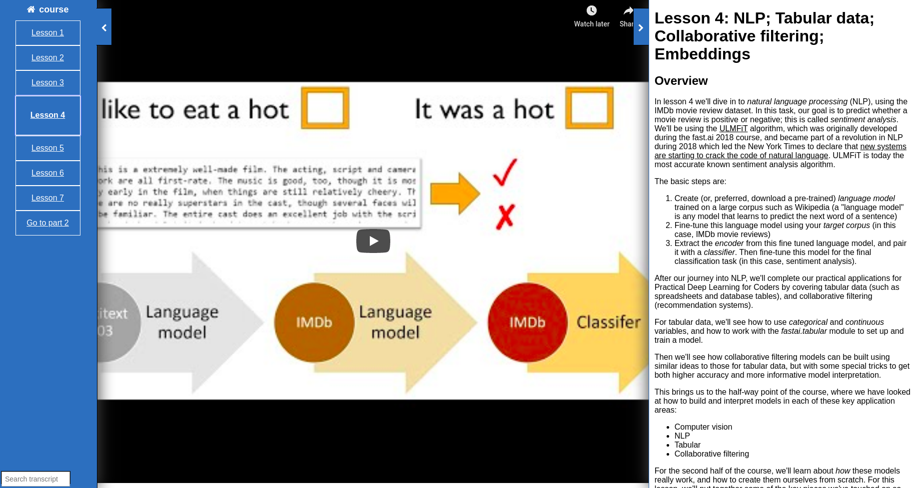
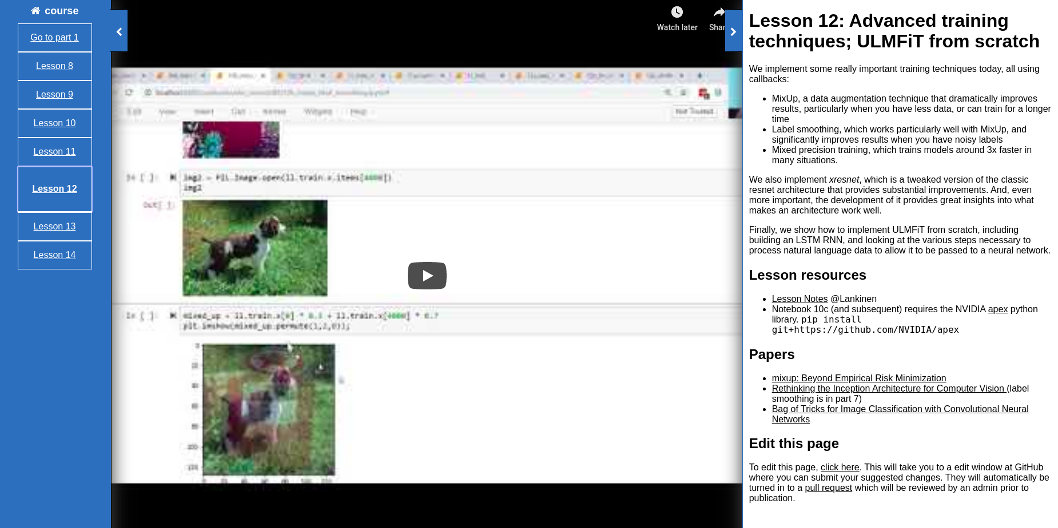
[1]: https://course.fast.ai/videos/?lesson=1
(18)
Notes:
they have a bunch of good videos with extra resources

Slide 19
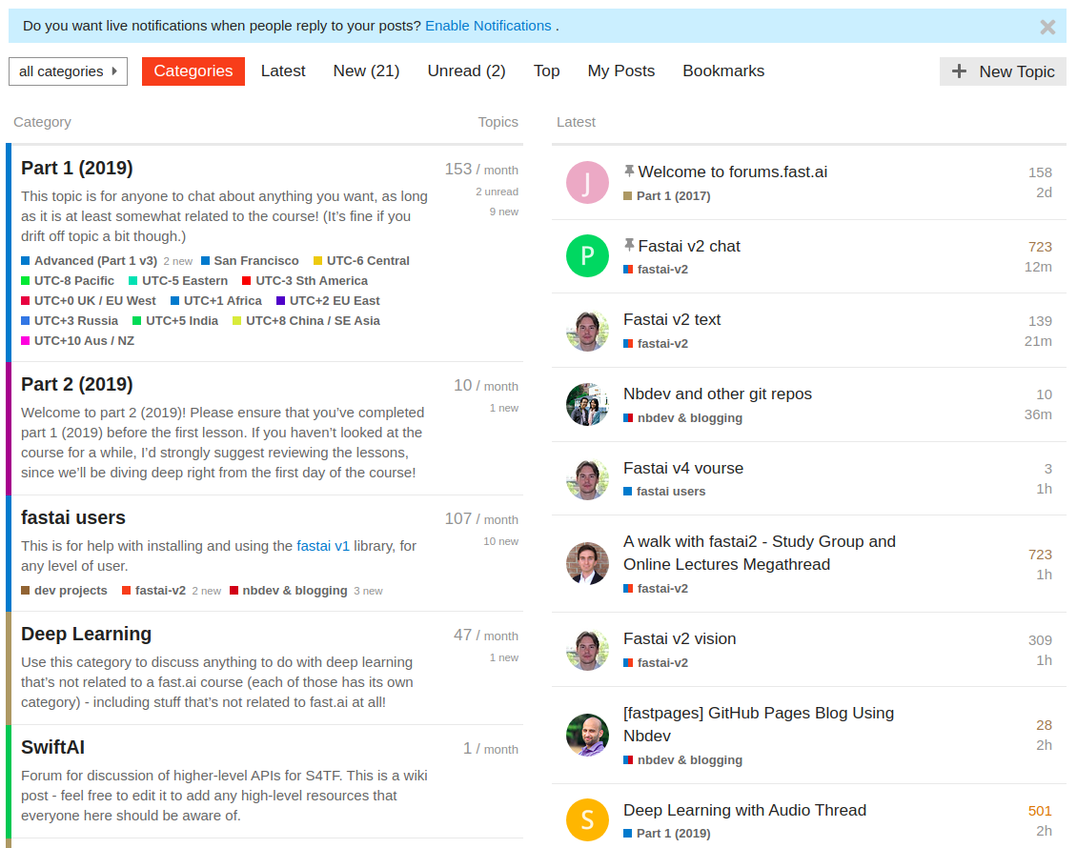
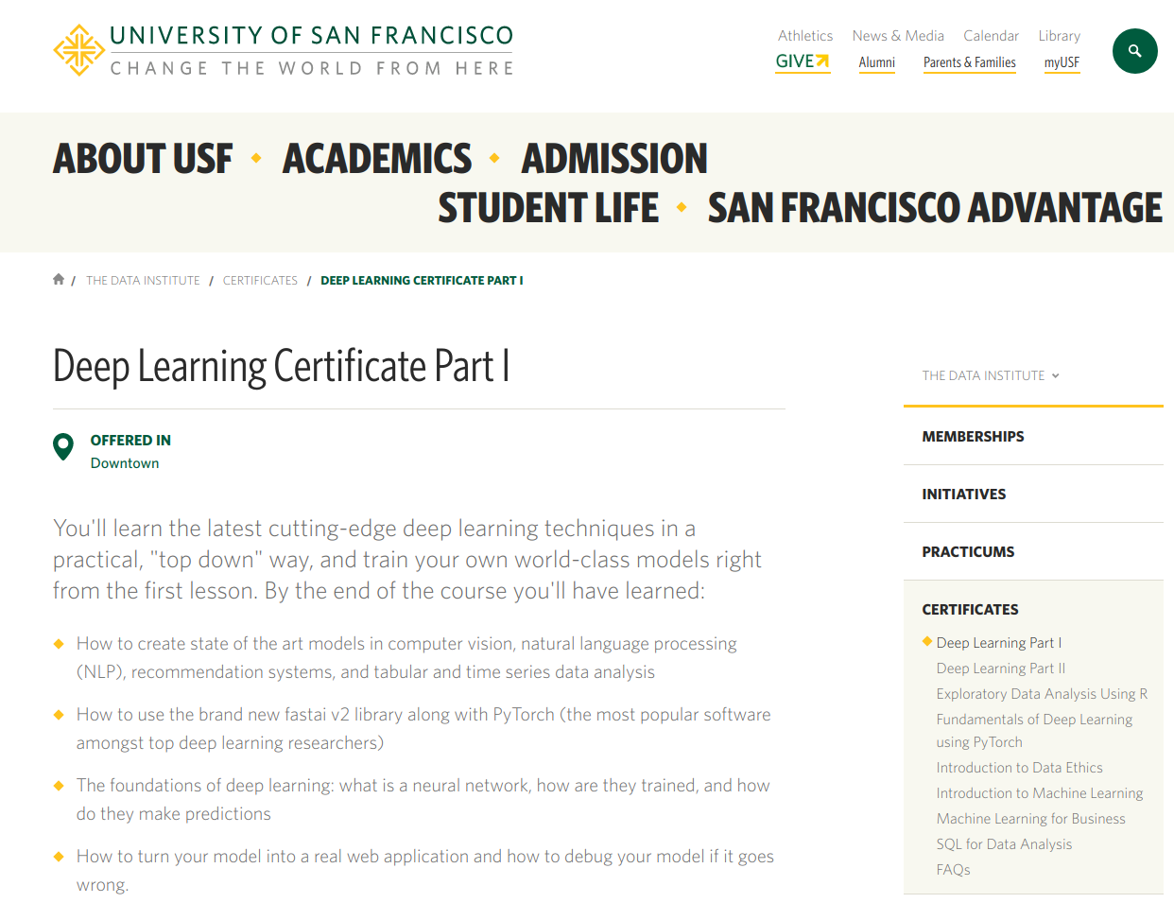
[1]: https://forums.fast.ai/
[2]: https://www.usfca.edu/data-institute/certificates/deep-learning-part-one
(19)
Notes:
They also have a cusotm forum, and are accepting course applications if you want to trying to take a swing at that.

Slide 20
*From Stephen Welch's 2/7/2020 CAIR presentation
1. Form a fastai study group, contribute to the fastai library
2. Making kick-ass RL tools, push RL research forward– work with Josiah on fastrl!
3. Unsupervised & one-class learning in manufacturing on the MVTech dataset. [Stephen] I’m personally offering a $250 bounty on this.
4. Open problem in manufacturing and autonomous driving – supervised model health monitoring
- how do we know when a model is no longer performing well without labeling new data?
5. Create a CAIR Kaggle Team
6. Amazon DeepRacer team – I believe Dr. Shin is forming a team
7. Create high quality educational AI resources (videos, blogs, books)- happy to help as I have time.
8. Summer internship working with Stephen Welch & Josiah at Mariner
9. Summer internship at Atrium working on AI for medical applications
(20)
Notes:
Finally, 2 weeks ago Stephen Welch who I work for had a lot of great points, and ill leave this up for those of you who are interested. He has a 250$ bounty on beating a bench mark, and my part 3 notebook has some ideas on how to work with that dataset

Slide 21
Thank you!
(21)

